Slide 1
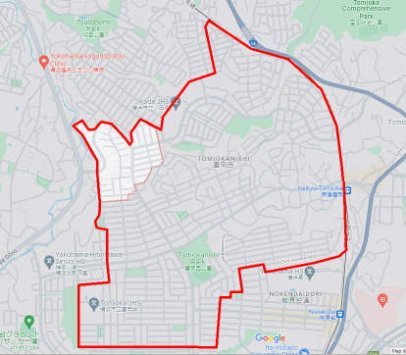
修正版(プログラム採用版)
2023/01/28
35.37574882601201,
139.62137656711673
35.37375189636854,
139.62615207124352
35.37126945661188,
139.62886244945108
35.37464657021711,
139.623189740366
35.372226597206556,
139.62819899144222
35.37527643251494,
139.6210117866997
35.36754482323006,
139.6296024603071
35.37306314467156,
139.6217413475337
35.36420166714637,
139.6297897196359
35.370596575495014,
139.61476348635583
35.370782160278,
139.61705458898427
35.37268696718477,
139.62013202216457
35.36376860001917,
139.6288186562702
35.37078029225879,
139.61403393574466
35.37029035292772,
139.61295028417166
35.37018828750506,
139.61840497406456
35.36310056060587,
139.62485183402688
35.36864433631068,
139.61438212951467
35.36947068533102,
139.61641732865053
35.36335187635167,
139.62481739887647
35.36653571408147,
139.61453772192408
35.363117271878345,
139.62314221968566
35.36228836275621,
139.61329511908966
(終端)
35.362423578862966,
139.61515999441446
35.36163108058289,
139.62334070015595
35.36170465505306,
139.6220415552594
35.359144224028974,
139.61329037072218
(スタート)
35.35920308545445,
139.62180698743086

