Slide 1
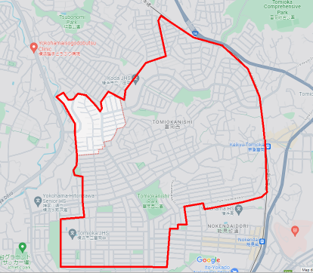
修正版(プログラム採用版)
2023/01/28
35.37574882601201,
139.62137656711673
35.37375189636854,
139.62615207124352
35.37126945661188,
139.62886244945108
35.37464657021711,
139.623189740366
35.372226597206556,
139.62819899144222
35.37527643251494,
139.6210117866997
35.36754482323006,
139.6296024603071
35.37306314467156,
139.6217413475337
35.36420166714637,
139.6297897196359
35.370596575495014,
139.61476348635583
35.370782160278,
139.61705458898427
35.37268696718477,
139.62013202216457
35.36376860001917,
139.6288186562702
35.37078029225879,
139.61403393574466
横浜市磯子区 杉田9丁目を追加
35.37018828750506,
139.61840497406456
35.36310056060587,
139.62485183402688
35.37029035292772,
139.61295028417166
35.36864433631068,
139.61438212951467
35.36947068533102,
139.61641732865053
35.36335187635167,
139.62481739887647
35.36653571408147,
139.61453772192408
35.363117271878345,
139.62314221968566
35.36228836275621,
139.61329511908966
(終端)
35.362423578862966,
139.61515999441446
35.36163108058289,
139.62334070015595
35.36170465505306,
139.6220415552594
35.359144224028974,
139.61329037072218
(スタート)
35.35920308545445,
139.62180698743086

Slide 2
再修正版(プログラム採用版)
2023/01/28
35.37574882601201,
139.62137656711673
35.37375189636854,
139.62615207124352
35.37126945661188,
139.62886244945108
35.37464657021711,
139.623189740366
35.372226597206556,
139.62819899144222
35.37527643251494,
139.6210117866997
35.36754482323006,
139.6296024603071
35.37306314467156,
139.6217413475337
35.36420166714637,
139.6297897196359
35.370596575495014,
139.61476348635583
35.370782160278,
139.61705458898427
35.37268696718477,
139.62013202216457
35.36376860001917,
139.6288186562702
35.37078029225879,
139.61403393574466
横浜市磯子区 杉田9丁目を追加
35.37018828750506,
139.61840497406456
35.36310056060587,
139.62485183402688
35.37029035292772,
139.61295028417166
35.36864433631068,
139.61438212951467
35.36947068533102,
139.61641732865053
35.36351410
139.61626070
35.36394967
139.61846500(新スタート)
35.36335187635167,
139.62481739887647
35.36653571408147,
139.61453772192408
35.36216810
139.61890850
35.363117271878345,
139.62314221968566
35.36228836275621,
139.61329511908966
(終端)
富岡西5丁目を 削除
35.362423578862966,
139.61515999441446
35.36163108058289,
139.62334070015595
富岡西6丁目を 下1/4を削除
35.36170465505306,
139.6220415552594
35.359144224028974,
139.61329037072218
(スタート)
35.35920308545445,
139.62180698743086

Slide 3
再修正版(プログラム採用版)
2023/01/28
arr_time
dep_time
total_distance
m_dep_time
m_arr_time
INCOMING
OUTGOING
arr_time
inPolygon_distance
dep_time
INSIDE
OUTSIDE

