Slide 1
“Mobility, social exclusion and well-being: Exploring the link”
Authors
John K. Stanley,
David A. Hensher,
Janet R. Stanley,
Dianne Vella-Brodrick
Publication Date
17 June 2011
Lab: Traffic and City
Student ID: 22WA003
Name: Tomoichi Ebata

Slide 2
Review of the previous presentation
“Subjective well-being related to
satisfaction with daily travel”

Slide 3




0-1. Terminology
Term | Outline | Others
Health | “Health is a state of complete physical, mental and social well-being and not merely the absence of disease or infirmity. | Definition by WHO
Well-being | A state of happiness and fulfillment in all aspects of life: physical, mental, and social | Using this icon →
Satisfaction | Fulfilment of one's wishes, expectations, or needs, or the pleasure derived from this. | Using this icon →
ー Positive emotions
ー Motivation and immersion
ー Awareness of self
ー Mindfulness
ー Psychological resistance/resilience
ー Empathy
ー Compassion and altruistic behavior
やる気と没頭
Similar
共感
Well-being
Satisfaction
思いやり・利他的行動

Slide 4
0-2. Definitions
Term |  | Contents | Ebata’s understanding
Subjective Well-Being : SWB) |  | ■No definition of "happiness" at all ■Answer "How happy do you feel about yourself" → Clarification ■Hence, the "survey" is the main focus. | No concept of "happiness that can be compared to others"
Two SWBs | (A)Cognitive SWB | ■Based on an individual's (self-imposed) assessment of well-being ■Also known as "life satisfaction“ ■Self-evaluations of other specific domains of life in general, such as work, consumption, health, relationships with family and friends, and leisure time (domain-specific SWB). | Personal "happiness" based on the "rules of our own happiness"
 | (B)Affective SWB | ■Positive emotions of joy, fulfillment, enjoyment ■Negative emotions such as sadness, anger, disappointment ■Response portion of the individual as determined from the above multidimensional | Happiness" based on feelings that arise spontaneously inside us, non-logically, without even rules within us.

Slide 5



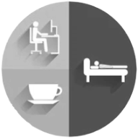
0-3. Conclusions
The impact of satisfaction with daily mobility (STS) on emotional and cognitive SWB is both direct and related by satisfaction with activity performance (SAS)
Direct
STS
SWB
Indirect
SAS
Car use plays only a minor role in satisfaction with daily mobility and its impact on SWB
SWB
STS
Small effect
×
Weekly use
SWB
Daily Satisfaction

Slide 6
1. Introduction

Slide 7












1-1. Background(1)
Links between mobility and social exclusion have been realized
Negative
relationships
Education
Medical
Employment
Social Exclusion
Without using car
Grocer
Sports
Leisure
Culture
(Cartmel and Furlong, 2000; Hine and Mitchell, 2003; Cass et al., 2005; Preston and Rae, 2007).
SWB
Good social
relationships
Reduced care costs
Increased productivity
Major Government Policies
(Keyes and Grzywacz, 2005; Lyubomirsky et al, 2005)

Slide 8


1-2. Background(2)
Relationship between Transportation Mobility and Happiness
Education
Medical
Employment
Transport Mobility
Serves
Psychological
well-being
Grocer
Sports
Leisure
Culture
Paper | Outline | Others
Mollenkopf et al., 2005 | How transport mobility contributes towards enhanced quality of life | Convenience of transportation is positively correlated with quality of life
Bergstad et al. 2011 | Emotional, social, and psychological aspects related to transportation mobility are receiving attention | Mobility of transit agencies has not consistently proven beneficial
Spinney et al., 2009 | Satisfaction with activity performance also found to mediate this relationship | Participation leads to a sense of independence.
Cantor and Sanderson (1999) | Participation in all tasks of life is important to well-being | Transportation has a greater purpose than just simply moving from one place to another

Slide 9
1-3. Background(3)
Self-Determination Theory (Deci and Ryan, 1985)
claims that people are motivated to achieve the following three factors
factors | Outline
(1)Competence | We belief that one has the resources to achieve important outcomes
(2)Relatedness | We have supportive and satisfying social relationships
(3)Autonomy | We feel an undertaking activities based on choice, self-determination
These three factors lead to our health(Deci and Ryan, 2000）

Slide 10
1-4. Background(4)
Model of Psychological Well-being (Ryff's 1989)
Comprehensive framework for assessing psychological factors as follows
factors | Outline
(1)Autonomy | One's self-determination, ability to sustain individuality, self evaluation and regulation of one's own behavior and personal standards
(2)Environmental mastery | A sense of competence and mastery and the ability to shape surroundings to meet needs.
(3)Personal growth | A sense of continued development and potential, making the most of one's talents and openness to new experiences.
(4)Positive relations with others | One's experience of affectionate, trusting, empathetic relationships and an understanding of the reciprocity of relationships.
(5)Purpose in life | A sense of goal directedness and life meaning and the belief in one's efforts.
(6)Self-acceptance | An awareness of one’s limitations and have a positive self-attitude.

Slide 11
2. Purpose of this study

Slide 12
2-1. Targets of this paper
Previous studies of Mobility and Well-being
Paper | Target | Results
Mollenkopf et al., 2005 | Extensive analysis of the relationship between mobility and subjective well-being among older adults in Europe. | Social exclusion is not covered.
Spinney 2009 | Investigating the relationship between mobility and well-being among older Canadians.
Currie and Stanley, 2008 | Survey on feeling connected to the community | No mention of relationship between social exclusion and well-being
Targets of this paper are,
To develop a single/simple modeling framework of the relationship between mobility, social exclusion, and subjective well-being
To evaluate previous studies using the above framework.
To investigate the linkages between mobility, social exclusion, and well-being from the viewpoints of this new framework

Slide 13
3. Target field

Slide 14
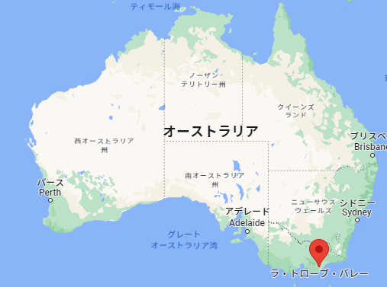

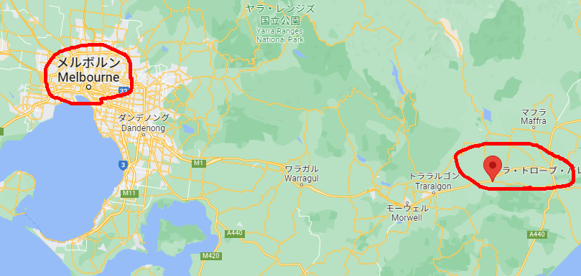
3-1. Overview
Experiment Field is Australia
■Two Areas in Australia
(1)Demographics
(2)Household composition
(3)Risk factors for Social exclusion
(4)Social capital and community ties
(5)Subjective and psychological well-being
(6)Personality
(7)Transportation usage
(8)Transportation difficulties
Melbourne (metropolitan area) (N = 535)
Latrobe Valley (rural areas of Victoria) (N = 148)
■Focus point
(A)To cover people and places to face transportation difficulties
(e.g many elders and youngers)

Slide 15
3-2. Overview(Con’t)
■Characteristics
Melbourne (metropolitan area) (N = 535)
Latrobe Valley (rural areas of Victoria) (N = 148)
Women, low-income households, and those living outside the city
Households born abroad, low-income households, owning two or more cars
Low use of public transportation in the region,
Socially disadvantaged (N=336)
→ Less spontaneous travel surveys
These are conditions to ask to join the Household Survey on Well-being and Social exclusion

Slide 16
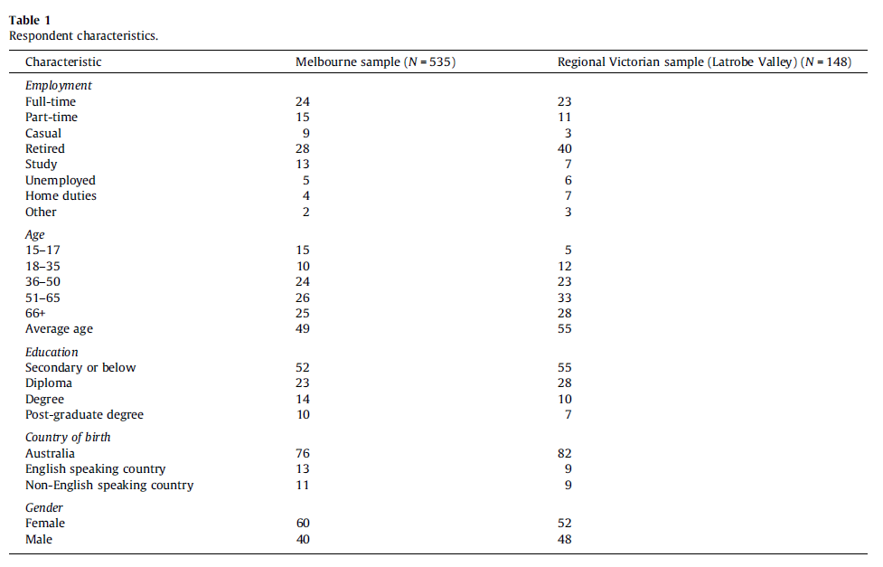
3-3. Overview(Con’t)
100%

Slide 17
4. Social Exclusion
A state in which, individuals are unable to participate fully in economic, social, political and. cultural life

Slide 18





4-1. Measuring risk of social exclusion
Five indicators variables for risk of social exclusion, and related thresholds
Modified 4 dimensions identified by the London School of Economics (Burchardt et al., 2002a,b)
Household income | Employment status | Political engagement | Participation | Social support
less than a threshold of $A500 gross per week. | not employed, in education or training, nor looking after family or undertaking voluntary activities. | - did not contribute to/participate in a government political party, campaign or action group to improve social/environmental conditions for a year | - did not attend one of the following: a library, sporting or exercise event, hobby, leisure or interest group, or arts or cultural event for a month | - not able to get help if you need it from close or extended family, friends or neighbors.
+1 Risk Point | +1 Risk Point | +1 Risk Point | +1 Risk Point | +1 Risk Point
A＄

Slide 19


4-2. Relations among the five dimensions of social exclusion
All measurements are relatively independent
Melbourne
Latrobe Valley
Income
Employment
status
0.11
0.18
Political
engagement
0.06
0.00
0.03
-0.08
0.18
0.07
0.32
The more a person is politically active, the more likely he or she is to participate in other activities.
Participation
0.15
0.04
0.27
Social
support
-0.02
-0.04
0.08
0.23
-0.10
0.19
0.10
0.07

Slide 20

4-3. Relations among the five dimensions of social exclusion
Numbers of risk points from each respondent and factor
Risk points of each respondent
Risk points of each factor
50
Melborune
Latrobe Valley
40
Melborune
Latrobe Valley
45
35
40
30
35
2/3 of total
25
30
25
20
20
15
15
10
10
5
5
0
0
Zero
Income
Employment
Policial
Participation
Support
None
One
Two
Three
Four
Five
engagement
“Employment” is not a major factor
Three major factors

Slide 21
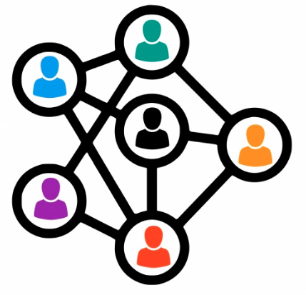
5. Social Capital

Slide 22
5-1. About Social Capital
“Social Capital” is a person's social network
and views on both trust and reciprocity(Stone et al.)
Factors | How to measure
(1)Social Network | Respondents keep in touch with those close to them (close relatives, extended family, friends / acquaintances)
(2)Trust | Respondents generally trust people
(3)Reciprocity | Respondents generally are to helped in the community
This is a “Capital”
Realized by (e.g.)
neighborly companionship
Summer festival(Bon dancing)
New Year's visit to a shrine
Respondents were asked on a three-point scale of "never“, "sometimes“, "always."

Slide 23
5-2. How to measure “Social Capital” in this study
People feel more connected to their community when they become actively by participating in community(Vinson,2004）
Paper | Contents
Stanley et al. (2011) | If they are in regular contact with significant others, feel attached to their community, are not low-income, mobile, and open to new experiences that allow them to grow on a personal level, they are less likely to be at risk of social marginalization
Spinney （2009） | The value of almost $A20 for additional trips
Introduced “Sense of Community Index” (Sarason (1974)、 McMillan and Chavis (1986)) → Responses were measured on a seven-point scale ranging from "strongly disagree" to "strongly agree"
A measure of different aspects to the community

Slide 24
6. Well-Being

Slide 25
6-1. How to measure “Subjective Well-being”
Ryff's (1989): psychological well-being scale is consistent with the following perspectives
factors
Autonomy
Environmental mastery
Personal growth
Positive relations with others
Purpose in life
Self-acceptance
XXXX: 0,1,2,…,10
XXXX: 0,1,2,…,10
SWB
Responses are on a 7-point scale ranging from "completely dissatisfied" to "completely satisfied"
questionnaire
SWB
XXXX: 0,1,2,…,10
The above three factors were selected by at least 0.4 points on two or three subjective well-being variables

Slide 26
7. Model Structure and the Results

Slide 27
7-1. Hypothesized model structure
Hypothesis
1. A person's risk of social exclusion is reduced if they don’t have strong social capital, mobility, and high-income;
2. Subjective well-being improves with low risk of social exclusion, high levels of environmental mastery, positive peer relationships, self-acceptance, and a strong sense of community
Psychological wellbeing:
Environment mastery
Positive relations with other
Self-acceptance
Household income
Trips
Social capital
Extraversion
Age
Sense of community
Risk of social exclusion(SOCEX)
Personal wellbeing(PWI)
Mobility, social exclusion, and well-being: hypothesis relationship

Slide 28
7-2. Reasons of the model structure
It was built from the results of statistical calculations and the contents of the previous studies
Psychological wellbeing:
Environment mastery
Positive relations with other
Self-acceptance
Household income
Trips
×
Trial
Social capital
Extraversion
Age
Sense of community
Added
（Diener et al.
1999）
Added
(Van Praag and Ferreri-i Carbonell, 2004; Cummins, 2011）
Strong
relationships
Strong
relationships
Risk of social exclusion(SOCEX)
Personal wellbeing(PWI)
Select three-step least squares (3SLS)
→ Against the problem of "overidentification constraints in other equations not being taken into account when estimating the parameters of a single equation."

Slide 29
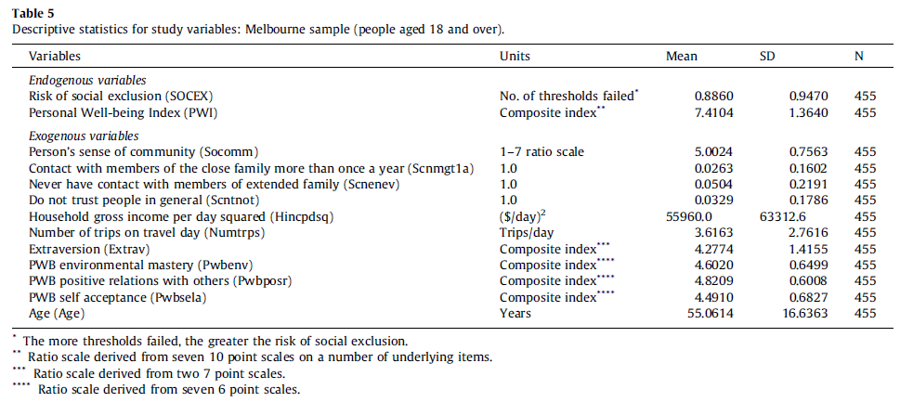
7-3. Metropolitan Melbourne (Data)
Mean, standard deviation, and sample size for each variable
The average age of all Victorians over 18 is “46 years-old” . The survey sample is heavily weighted toward the elderly.

Slide 30
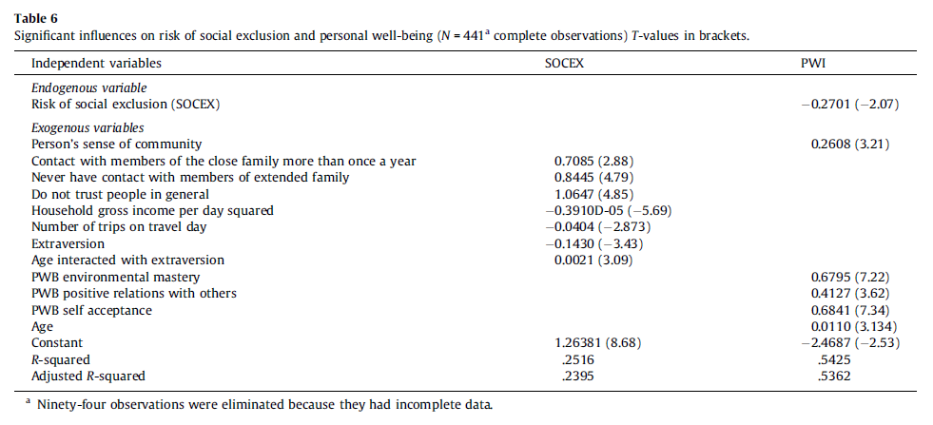
7-4. Metropolitan Melbourne (Modeling Results)(1)

Slide 31
7-5. Metropolitan Melbourne (Modeling Results)(2)
The lower the relative risk of social exclusion (SOCEX),
the more personal well-begin they have
A.
C.
Psychological wellbeing:
Environment mastery
Positive relations with other
Self-acceptance
Household income
Trips
B.
0.6795
Social capital
Extraversion
Age
0.4127
B.
- 0.000003910
-0.0404
0.6841
Sense of community
-0.1430
(Down)
0.0021
“Age” maintains PWI even as “Extraversion” declines
Significant association with risk of social exclusion
0.7085
0.0110
(Up)
0.2608
（Schneider and Gibbins, 1982; Mroczek and Kolarz, 1998）
Risk of social exclusion(SOCEX)
Personal wellbeing(PWI)
A.
-0.2701
C.
Extending the framework is not good
→ It is easier to find the relations, separated “social exclusion” from “personal wellbeing”

Slide 32
7-6. Metropolitan Melbourne (Modeling Results)(3)
Costs of Social Exclusion are different
by “travel” and/or “household income”
Marginal utility of trips = 0.0404.
Marginal utility of household income = 2 * 0.000003910 HINCPD (HINCPD = Household income per day = $A211.70 at average full sample level).
Marginal rate of substitution between trips and household income (or marginal value of trip) = MUTRIPS/MUHINC (at average household income) = $A24.40.
Almost same of the previous study(Van Praag and Ferrer-i-Carbonell（2004）)
Just one trip can result in a significant change(profit)

Slide 33
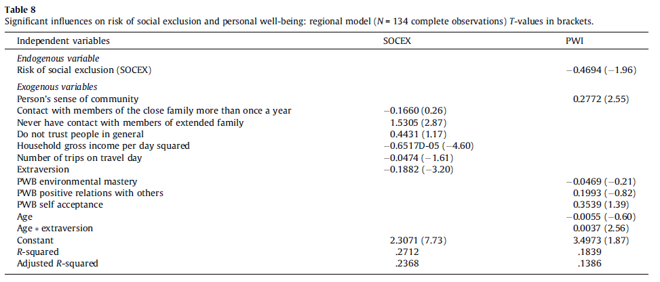
7-7. Regional Victorian(Data)

Slide 34
7-8. Regional Victorian(Modeling Results)(1)
People in rural areas do not have the same psychological well-being of people in cities ?
Three variables of personal well-being were not significant in PWI model
Psychological wellbeing:
Environment mastery
Positive relations with other
Self-acceptance
Household income
Trips
0.3539
Risk of social exclusion and age also significant
Social capital
Extraversion
Age
0.19993
- 0.000006517
-0.0474
-0.0469
Sense of community
-0.1882
-0.0474
0.4431
0.0037
0.27772
Risk of social exclusion(SOCEX)
Personal wellbeing(PWI)
Community awareness suggests stronger relations than Melbourne results
-0.4694
People in rural areas may have fewer diverse experiences and opportunities?

Slide 35


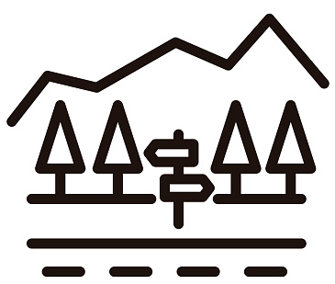





8-1. Conclusion
Significant relations between increased mobility (travel and activities) and reduced risk of social exclusion
# | Contents | Ebata’s Summary
1 | Risk of social exclusion may be reduced by policies and programs that promote the development of social capital, especially in metropolitan settings | Risk of social exclusion might be controllable
2 | Risk of social exclusion is significantly associated with individual well-being in both metropolitan and regional area | Few different results between urban and rural
3 | Increased mobility is an indirect means of potentially improving well-being | Mobility improves well-being
4 | Fostering attachment to the community is also associated with improved individual well-being. | Community Activities improve Well-Being
5 | In proposed framework considered, the gains from new trips are significant. | Profits of travel are larger
6 | The cost of a trip should be more about the number of (short) trips than the distance. | Numbers of trip is more important than the distance

